Slide 1



HIV Database Workshop www.hiv.lanl.gov seq-info@lanl.gov
Presenters: Will Fischer, Brian Foley, Bette Korber
Database PIs: Bette Korber, Thomas Leitner,
Karina Yusim, Brian Foley
Additional database staff: Werner Abfalterer,
Elizabeth-Sharon Fung, Kumkum Ganguly, Jennifer Macke, James Szinger, Hyejin Yoon
Contract Officer Representative: Anjali Singh, NIAID, NIH
Theoretical Biology and Biophysics, T-6
Los Alamos National Laboratory

Slide 2
Workshop Topics
HIV Sequence Database
General introduction
Sequence search interface – alignments and basic trees
Geography search interface
Database Alignments
Tool Examples:
GeneCutter – proteins from nucleotide sequences (HIV, SIV)
TreeMaker (Neighbor Joining)
Sequence Locator tool: HIV, SIV, HCV, HFV
QuickAlign: HIV, SIV, HCV, HFV
Variable Region Characterization
Highlighter
Entropy
Hypermut
Quality Control (HIV)
Notes:
Today we’ll be taking you through a quick tour of some highlights only of the HIV database: we’ll include some basic access techniques, i.e. some of the search interfaces, and some of the tools that deal with the peculiarities of HIV sequence data. We will only scratch the surface in the time we have available, so keep in mind that we’re always available to answer questions, to point you to existing tools, and to consider suggestions for new ones!

Slide 3
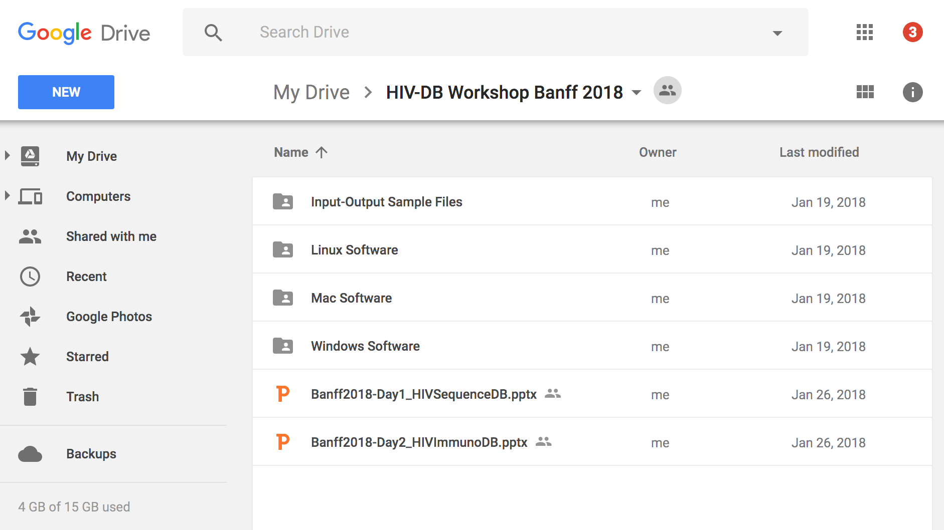
Datasets and programs
http://tinyurl.com/HIV-DB-2018
Aliview
Bioedit
Figtree
updated slides
datafiles
Notes:
All of our tools have sample inputs built in, but we’ve included here some other sample datasets as well as some external tools that any serious bioinformatician ought to have available.

Slide 4
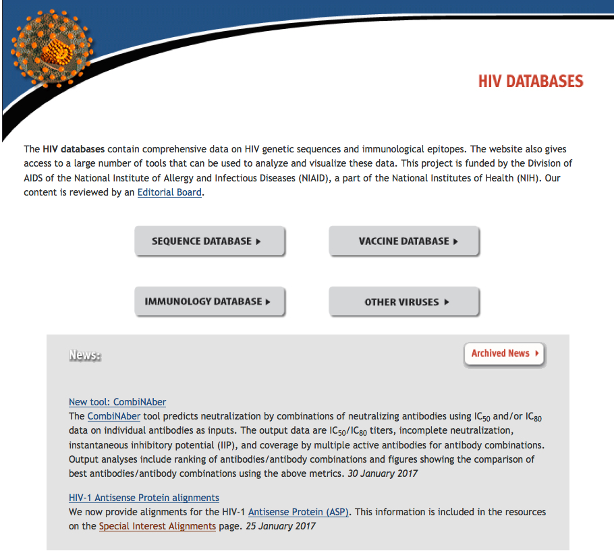
Entry page at http://www.hiv.lanl.gov/
Notes:
You all saw this entry page yesterday, when we had you click [here] on the immunology database button. Today we’ll go into the sequence database.

Slide 5
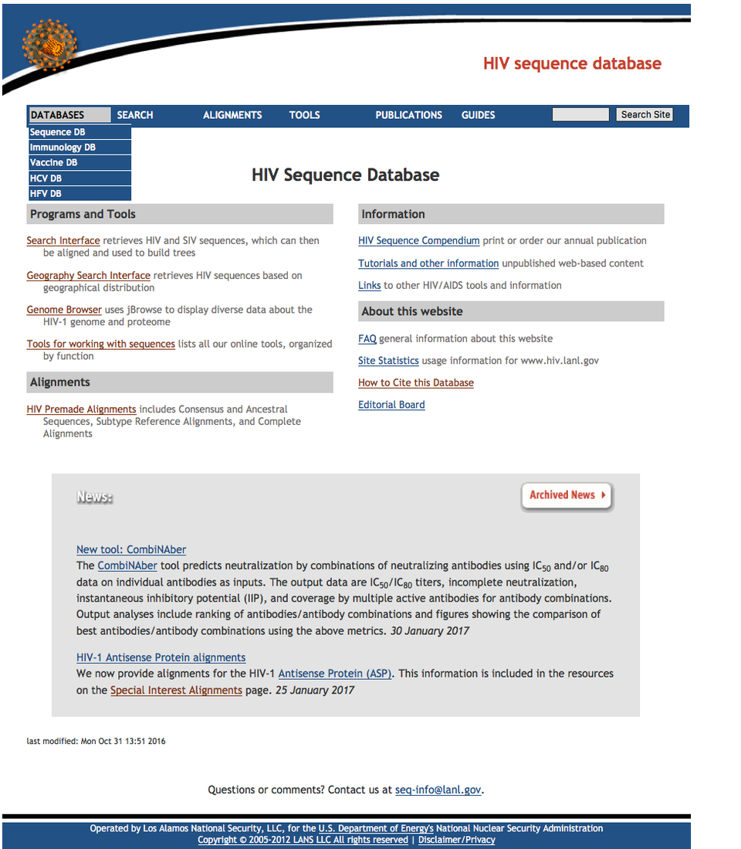
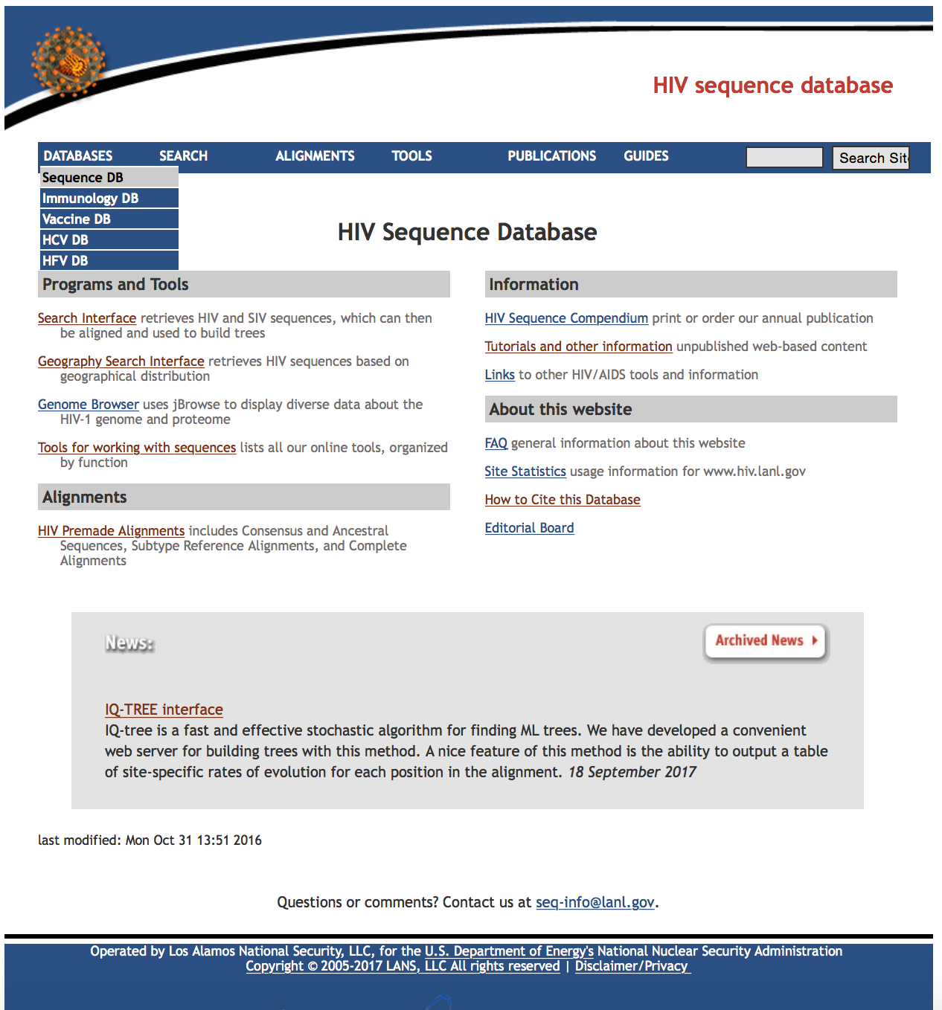
Notes:
I’d like to point out again that the header bar here has drop-down menus

Slide 6
Multiple paths to
most tools

Slide 7
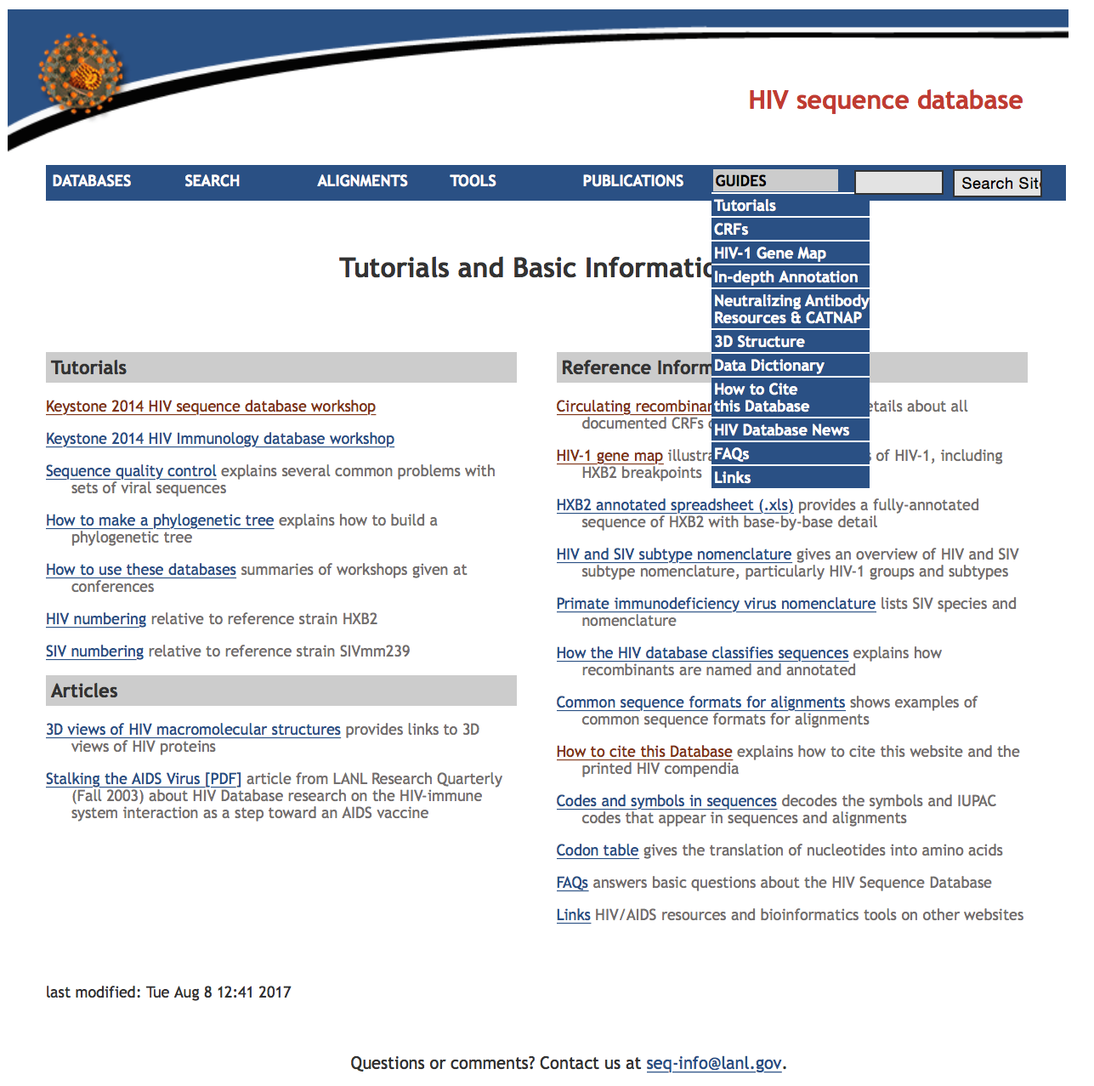
All kinds of basic information about HIV and about our database
Previous workshop presentations
Yes! We do respond to this e-mail address!
seq-info@lanl.gov

Slide 8
Search Interface
Results (what you want)
Can download aligned or unaligned sequences
Alignments based on multiple pairwise alignments – alignments are good, but need hand editing for an optimal alignment
Select all or a subset of sequences for download
Sequences can be re-ordered by clicking on fields at the top of the page, and names customized
Searches (how you get it)
Searches are case-insensitive
Records are searchable through sequence, patient, genomic region, or publication information and can be matched to the genomic region of a user-provided alignment
First seven fields will appear in search results page by default
A “*” in a textbox will cause that field to be included in the results page
Patient information (Infection year, Infection country) is different than sequence information (Sampling year and Sampling country)
Problematic sequence filters (hypermutation, frequent ambiguities, potential contamination)
Analysis (what you can do with it)
Build a tree with user alignment, search results and subtype reference sequences combined
Help (if all else fails, read the instructions!)
Tips at the top of the page are often overlooked
Ranges, operators, wildcards, logical groupings
Mouse-over provides brief descriptions; click field names for details in Help file

Slide 9
Today’s Sequence Search example workflows
Assemble a country-wide whole-genome data set:
Get all available complete genome sequences from a given country (Brazil)
Include patient health and sampling city information
Add in subtype reference sequences and make a phylogenetic tree for quick evaluation
Download the sequences as a phylogenetically sorted alignment; look at the alignment!
Clean up alignment and extract spliced coding sequences (GeneCutter); look at the alignment(s) again!
Other approaches (search and evaluation)
Geography Search interface
Advanced Search (ask us afterwards!)

Slide 10
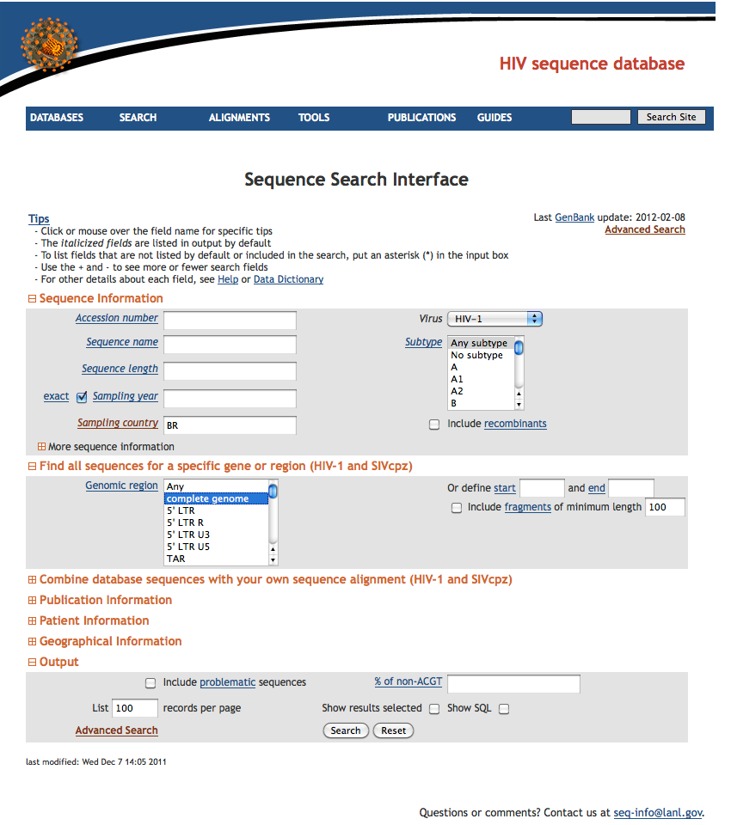
We will search for country = Brazil (BR)
We will search for complete genomes.

Slide 11
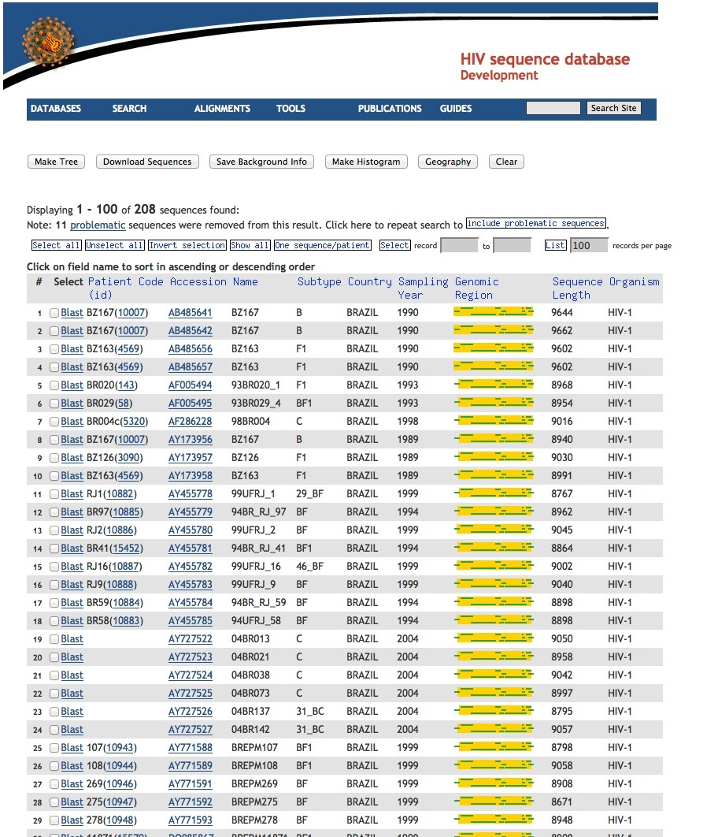
Results for HIV-1 complete genomes from Brazil
Choose
“One sequence/patient” to remove very similar sequences
(only available if a region is selected)

Slide 12
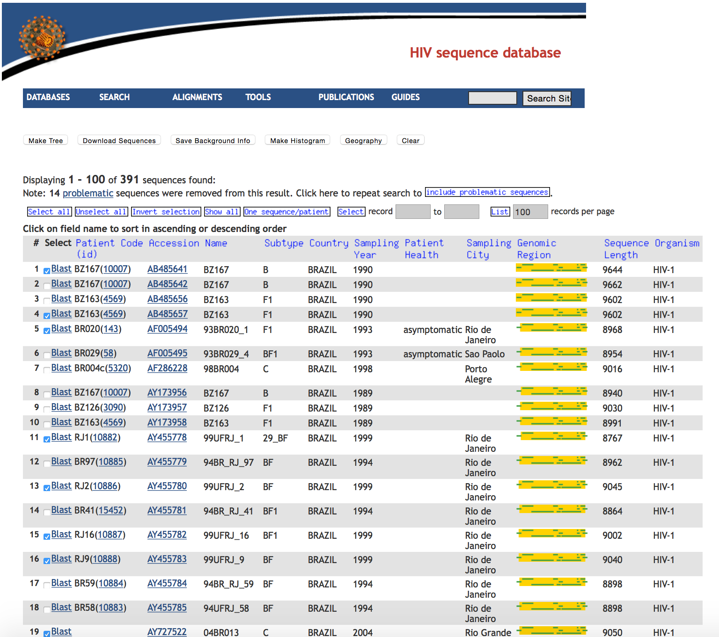
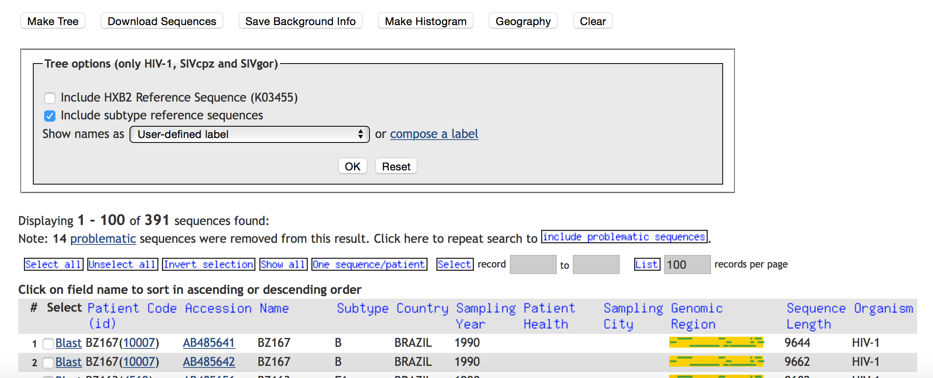
For real use, download background data
Select a few sequences
and make a tree.
We can add a reference set to our data and align them all together.

Slide 13
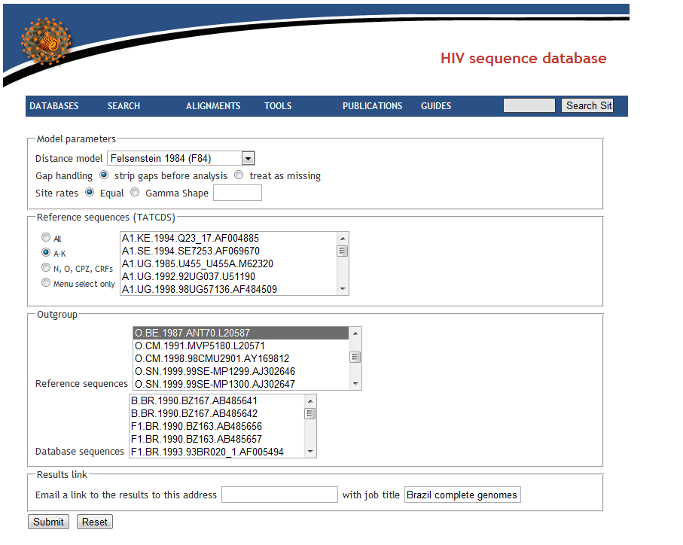
TreeMaker tool
Choice of outgroup influences the presentation of the tree.
In general, choose next closest sequences to the “ingroup”.
In this case our Brazilian sequences are all HIV-1 M group.
Alternatively, leave blank for midpoint rooting
These settings may change relative branch lengths somewhat,
but rarely alter the tree topology.
Our Brazilian sequences
Optional mailback, and tree title

Slide 14
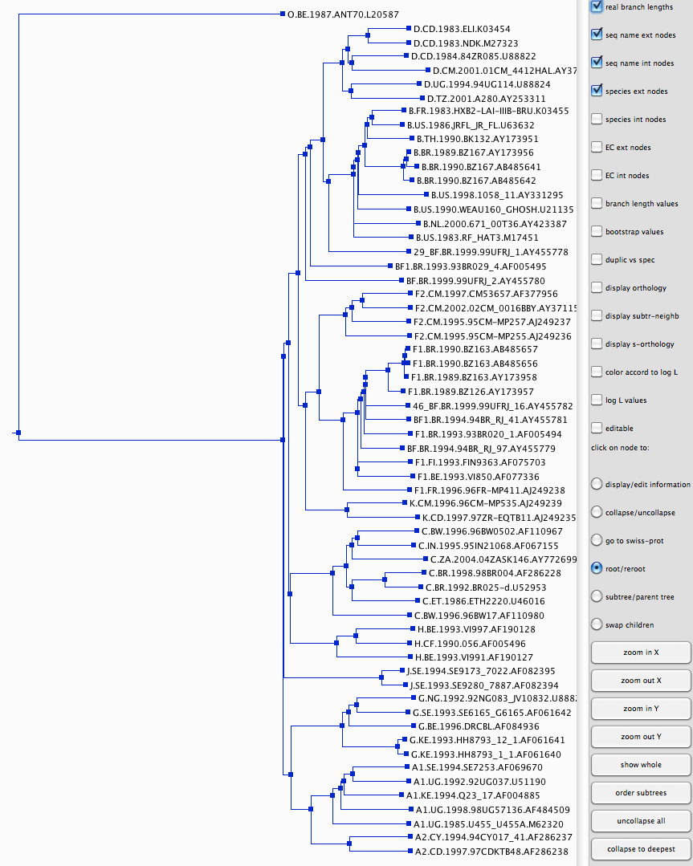
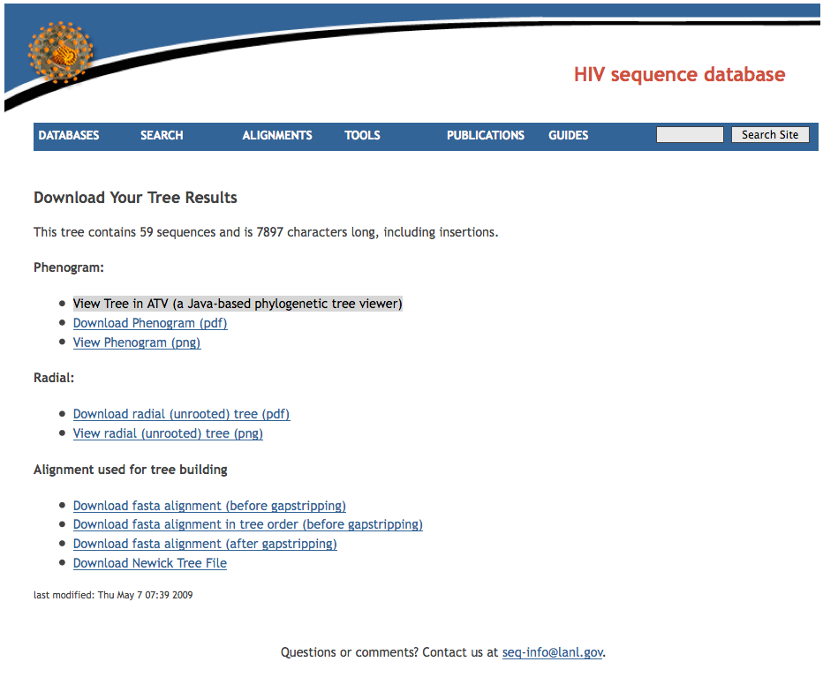
ATV is a java-based view for a quick look and manipulation; cannot save/print
Save alignment, use BioEdit or Aliview to view/adjust.
Use FigTree or other programs to view Newick
tree files.
Obtaining your sequences of interest and having them aligned to a good reference set was the whole point of this. The tree was just a first check on data and alignment quality.

Slide 15
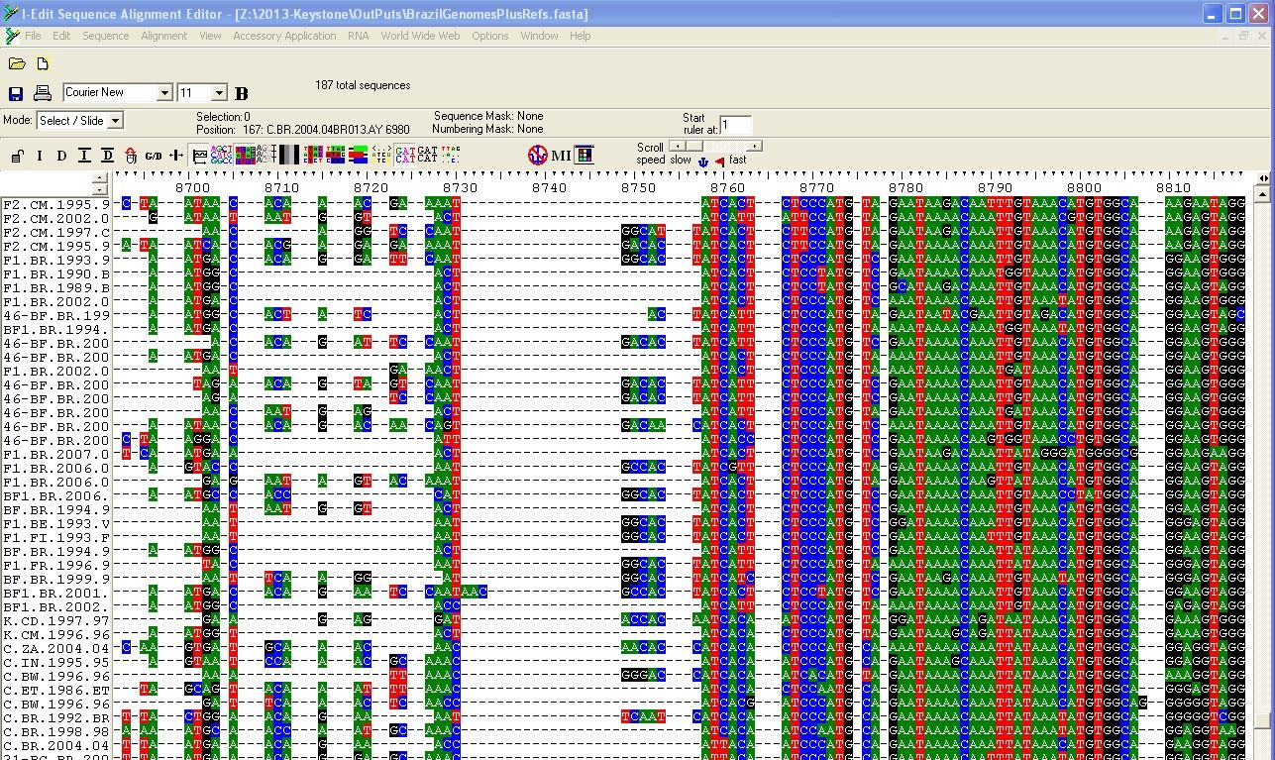
Save alignment, use BioEdit, Aliview, or SeAl to view/adjust.
Sending the alignment through GeneCutter or HIV-Align will often improve tree quality.
Brazil Genomes Plus Subtype Reference Set

Slide 16
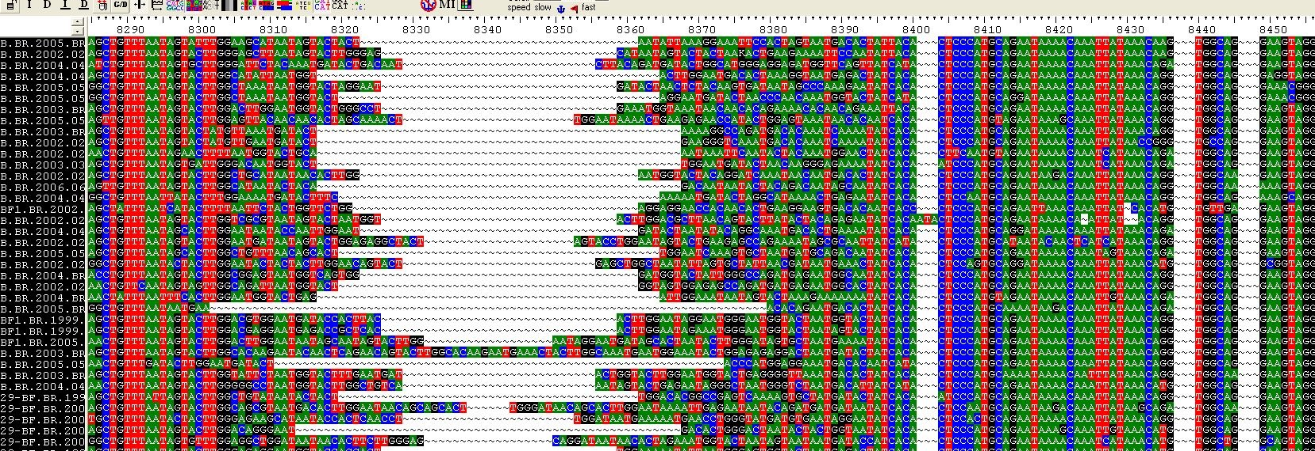
Quick Alignment from Search Interface has many “broken codons”
GeneCutter tool aligns by intact codon
(so sequences are “codon-aligned”)

Slide 17
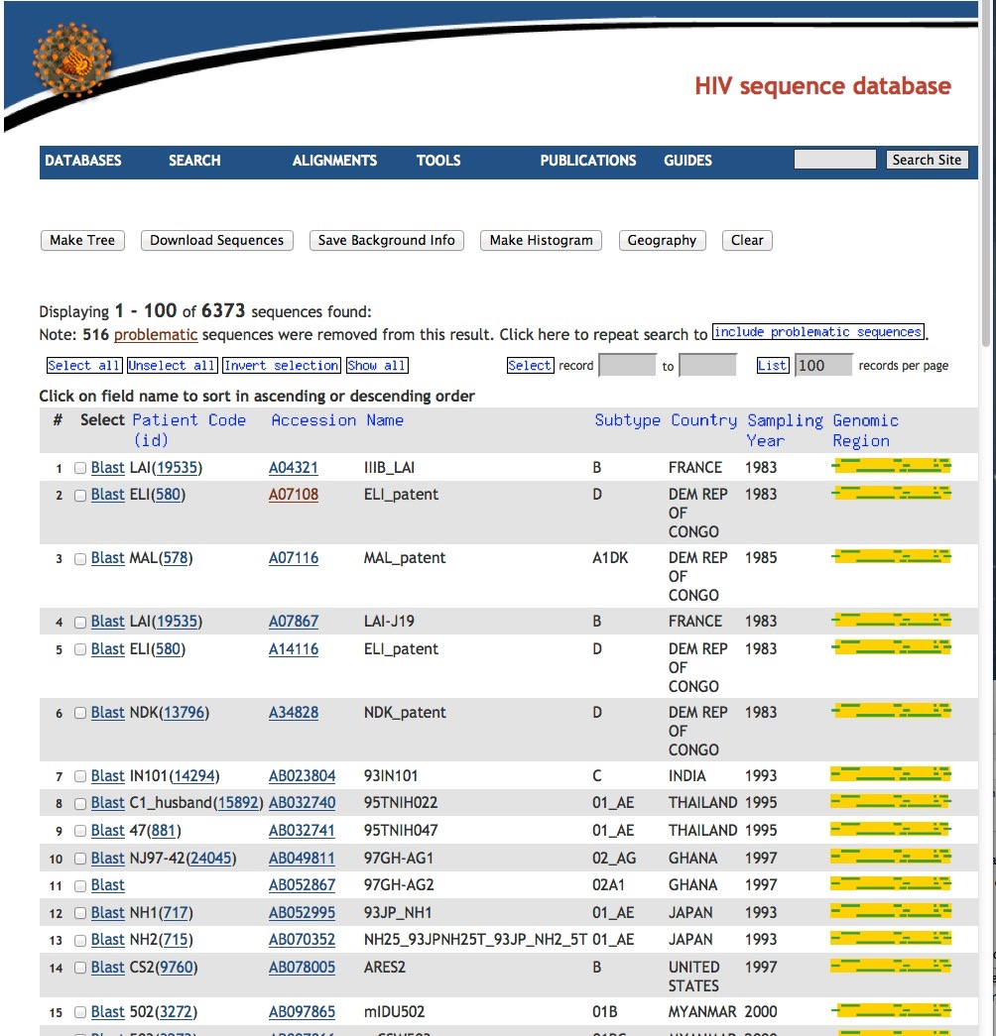
New search: all complete genomes; then look at geographic and subtype distribution of the sequences

Slide 18
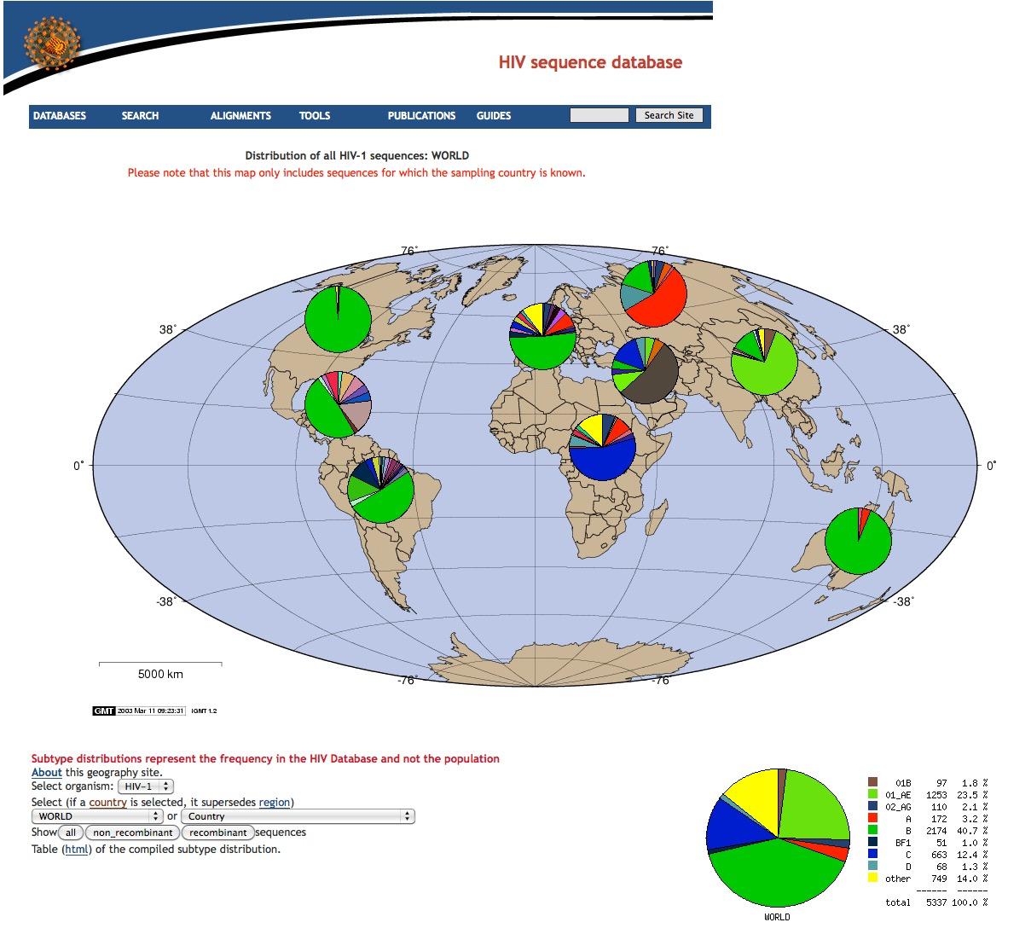
Geography output
Each continent’s pie chart is clickable to “zoom in” on that continent.
Likewise for each country once you are zoomed in to the continent level.
Most complete genomes in the HIV database are subtype B. But subtype C is more prevalent in human infections. Beware of this type of sampling bias.

Slide 19
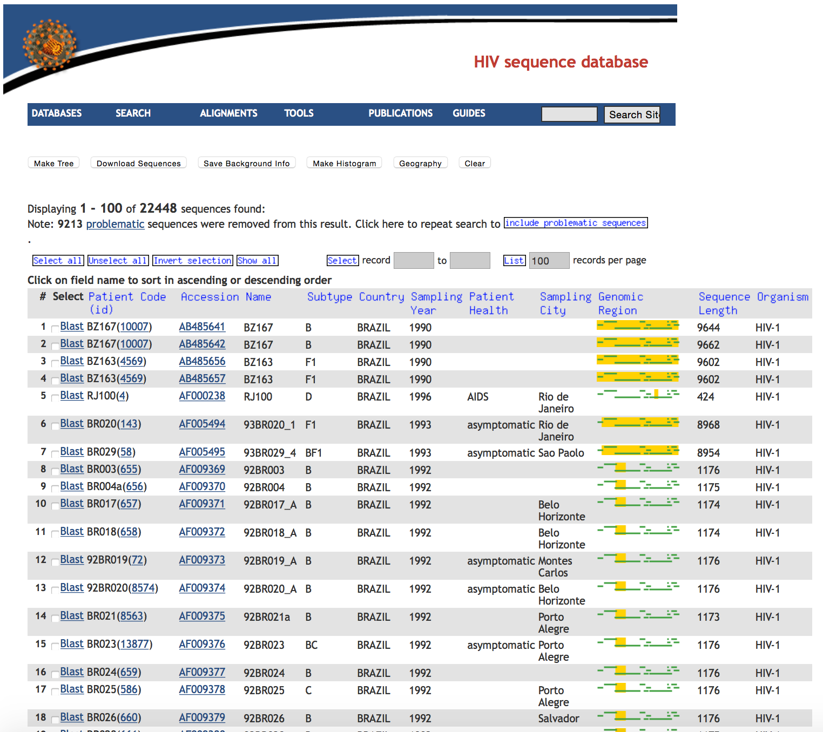
New search: all sequences from Brazil. Then look at the distribution of the sequences over the genome

Slide 20
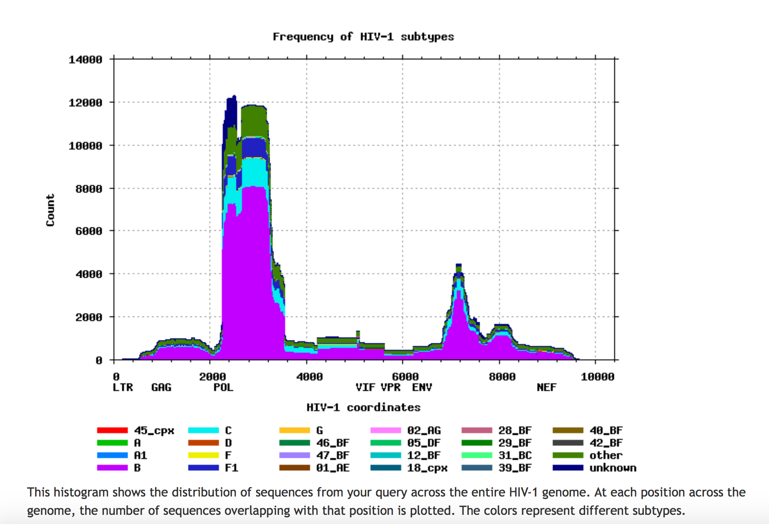
Histogram output

Slide 21
Pre-Built Sequence alignments
Based on both manual and HMM alignments
Manually curated
Alignments are in reading frame (codon aligned)
Contain non-redundant data (one sequence per patient)
Compendium alignments show a small “readable” subset
Reference alignments contain up to four representatives of each subtype (CRFs optional).
Useful to provide context for newly generated sequences!
Protein alignments with frameshifts compensated
Subtype consensuses and “maximum likelihood ancestors” are available for reagent production
Special interest alignments
Sequence sets (“authors’ alignments”) of particular research interest
Suggestions and additions welcome!

Slide 22
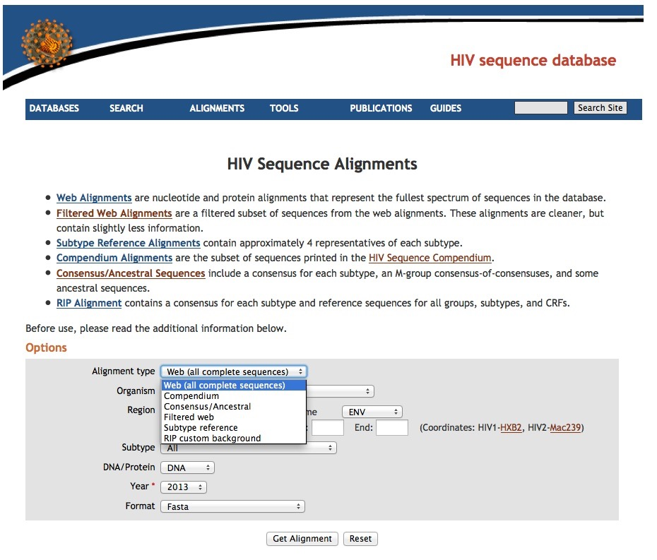
All (complete) = one per patient, all sequences for which we have a complete genome, or a complete gene.
Subtype Reference = 4 representatives of each subtype, plus one of each Circulating-inter-subtype-Recombinant-Form (CRF) of the M group, plus 4 O group, N group, P group, and SIV-CPZ
Consensus/Ancestral computed from master alignment periodically
(at this point in the pandemic there is little year-to-year change).
Explanations of the content of the different alignments are shown lower on the webpage.

Slide 23
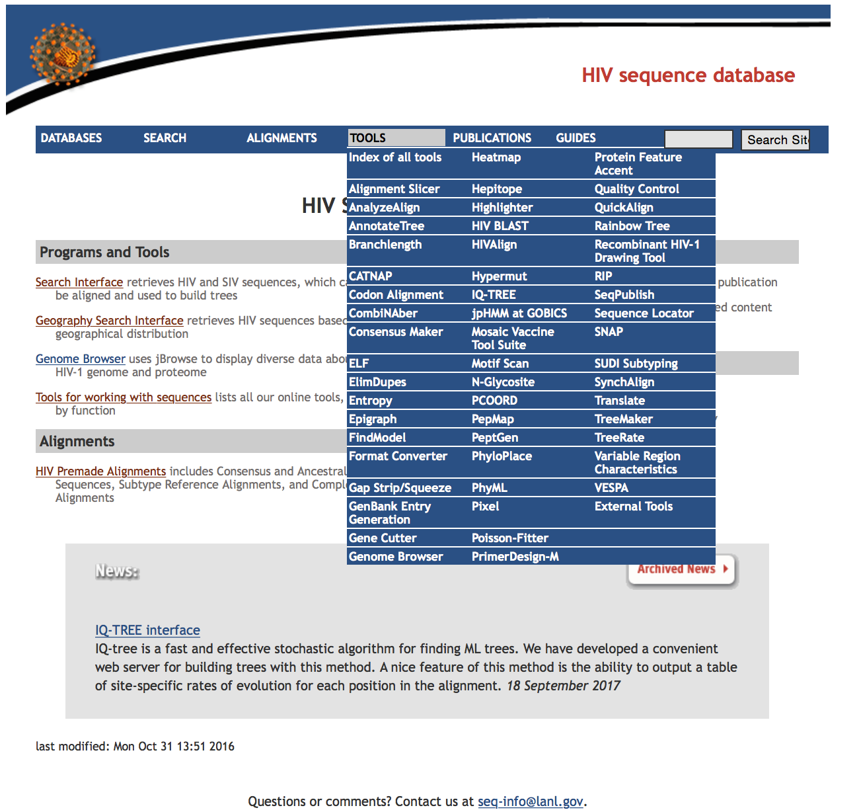
The HIV database sequence analysis tool set
Click top level to link to full page
of tools

Slide 24
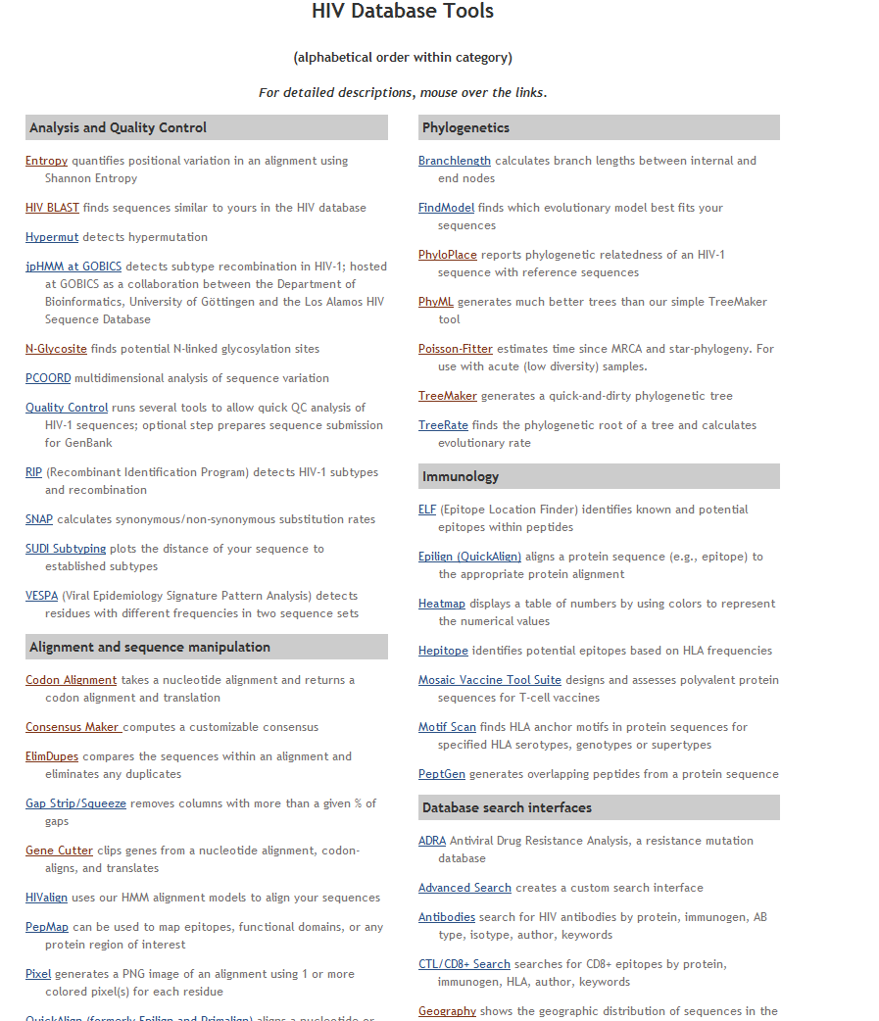
Tools are organized in groups
by function/purpose.
Most tools have explanation
pages, and sample data sets.
Many tools were inspired by user comments, please ask for more.
More below!

Slide 25
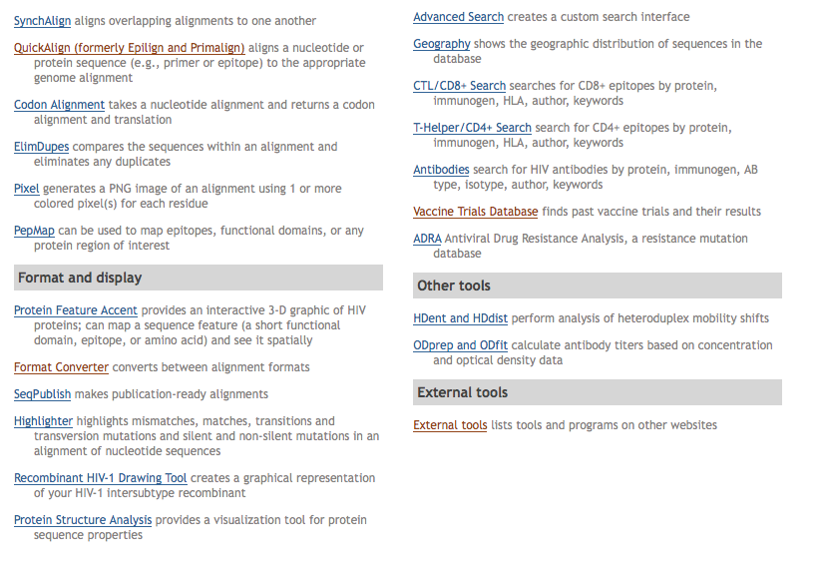
We list a selection of external tools of significance in HIV informatics.
Many of these tools are essential, such as either BioEdit or Aliview for alignment viewing and correction.
http://www.hiv.lanl.gov/content/sequence/HIV/HIVTools.html

Slide 26
Tools (a selection)
Analysis and Quality Control
Entropy identifies regions of proteins that are more conserved, or less conserved.
Hypermut identifies genomic regions affected by APOBEC-induced hypermutation.
Quality Control performs HyperMut, RIP subtyping, Treemaker, GeneCutter, etc…
N-Glycosite finds potential N-linked glycosylation sites.
RIP (Recombinant Identification Program) detects HIV-1 subtypes and recombination.
AnalyzeAlign in depth analysis of epitopes, continuous or discontinuous.
Variable Region Characterization unique tool for unaligned/unalignable V-regions
Alignment and sequence manipulation
Gene Cutter and HIValign align your sequences and extract protein-coding reading frames.
Phylogenetics
TreeMaker generates a neighbor-joining phylogenetic tree.
PhyML generates a maximum likelihood phylogenetic tree.
IQ-TREE generates a fast maximum likelihood phylogenetic tree.
TreeRate finds the phylogenetic root of a tree and calculates evolutionary rate.
Rainbow Tree Adds colors and symbols to trees.
AnnotateTree maps quantitative information to branch weights and colors.
Format and display
Highlighter highlights differences within an alignment of nucleotide sequences.
Pixel makes compact images of large alignments.
Recombinant HIV drawing tool makes graphical representations of recombinant genomes
Genome Browser shows structural and immunological features of HIV

Slide 27
Tools (a selection)
Analysis and Quality Control
Entropy identifies regions of proteins that are more conserved, or less conserved.
Hypermut identifies genomic regions affected by APOBEC-induced hypermutation.
Quality Control performs HyperMut, RIP subtyping, Treemaker, GeneCutter, etc…
N-Glycosite finds potential N-linked glycosylation sites.
RIP (Recombinant Identification Program) detects HIV-1 subtypes and recombination.
AnalyzeAlign in depth analysis of epitopes, continuous or discontinuous.
Variable Region Characterization unique tool for unaligned/unalignable V-regions
Alignment and sequence manipulation
Gene Cutter and HIValign align your sequences and extract protein-coding reading frames.
Phylogenetics
TreeMaker generates a neighbor-joining phylogenetic tree.
PhyML generates a maximum likelihood phylogenetic tree.
IQ-TREE generates a fast approximate maximum likelihood phylogenetic tree.
TreeRate finds the phylogenetic root of a tree and calculates evolutionary rate.
Rainbow Tree Adds colors and symbols to trees.
AnnotateTree maps quantitative information to branch weights and colors.
Format and display
Highlighter highlights differences within an alignment of nucleotide sequences.
Pixel makes compact images of large alignments.
Recombinant HIV drawing tool makes graphical representations of recombinant genomes
Genome Browser shows structural and immunological features of HIV

Slide 28
Common problems with HIV sequences
Genome structure
multiple overlapping reading frames, splicing, frame-shifting, error-prone replication
Viral biology
hypermutation
recombination
Laboratory/Data processing
contamination
location specification
fragile sequence identifiers
(partial) solutions
Alignment / reading frame tools
Gene Cutter and HIValign align your sequences and chop out proteins.
Pixel makes compact images of large alignments.
Entropy identifies regions of proteins that are more conserved, or less conserved.
Hypermutation/recombination/contamination tools
Hypermut identifies sequences that have been hyper-mutated by APOBEC-3G or other restriction factors.
Highlighter reveals discordance within groups of putatively related sequences.
RIP (Recombinant Identification Program) detects recombination between HIV-1 subtypes.
TreeMaker generates a neighbor-joining phylogenetic tree.
Quality Control performs HyperMut, RIP subtyping, Treemaker, GeneCutter, etc…
Location identification
Sequence locator unambiguously locates DNA and amino-acid sequences relative to a standard reference.
GenBank Entry Generation does what it says
Sequence identifiers
Search interface simplifies generation of uniform sequence names with useful information.

Slide 29
Gene Cutter
Unconventional Alignment/Homology program specialized for HIV
copes with indels (“dead” viruses), IUPAC ambiguities, overlapping (multi-frame) coding sequences, “unalignable” variable regions
produces DNA alignments by codon, as well as amino-acid alignments for multiple genes
Aligns to reference sequence (HXB2 or SIV-Mac239) via HMMer
Splits sequences into genes, and translates each gene to protein
Useful for processing new sequence data
annotating full length genomes
pulling out regions of interest from raw sequence data
For each gene/region, maintains a list of anomalies
stop codons
codons containing multi-state characters
codons containing indels (frame-shifted)
Including HXB2 as a reference may improve results
Does not address hypermutation or recombination
(see “Hypermut” or “RIP”)

Slide 30
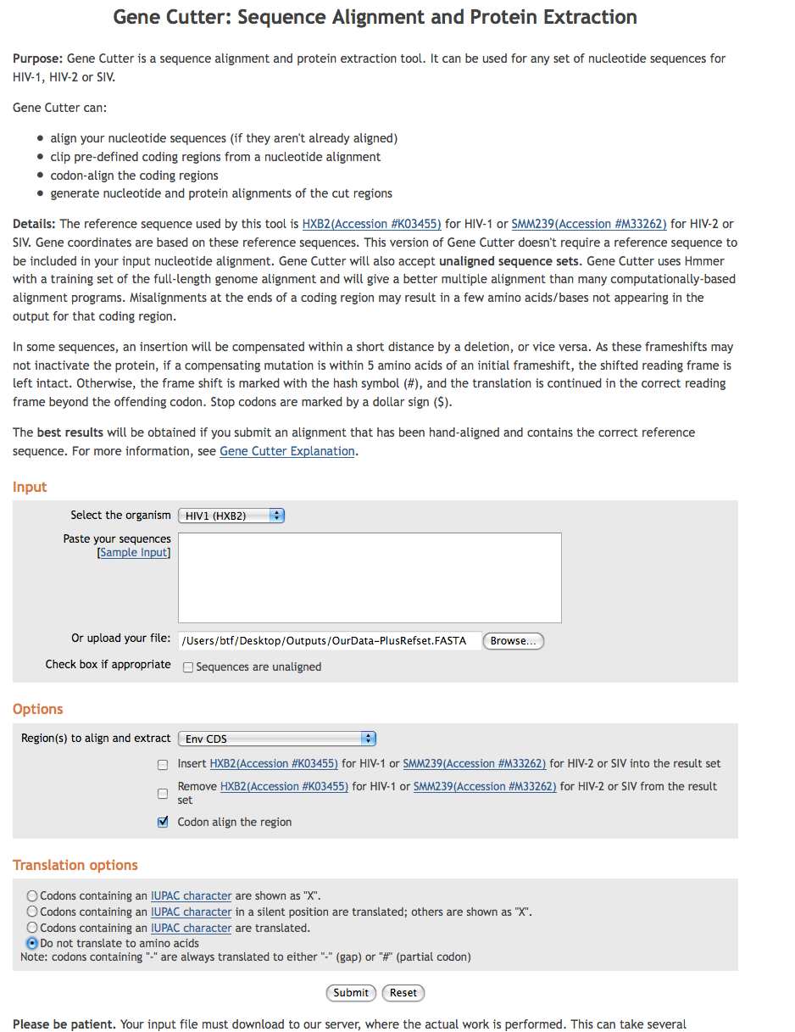
Gene Cutter
Input is our data plus the “reference Set” and any other sequences we chose to add from the search interface.
Input: GeneCutterInput.FASTA
For this exercise, we want the Env gene, codon aligned, but not translated to proteins.
Output: GeneCutterOutput.FASTA

Slide 31
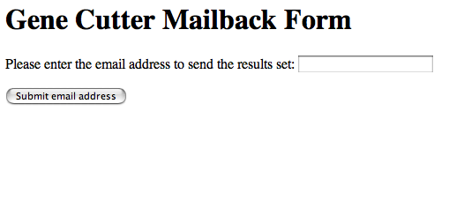
Gene Cutter Results
Results are stored on our server
An HTML link is e-mailed to the user when the run is complete
For this workshop, we will provide example files.

Slide 32
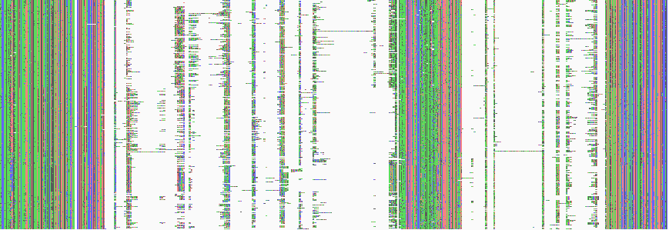
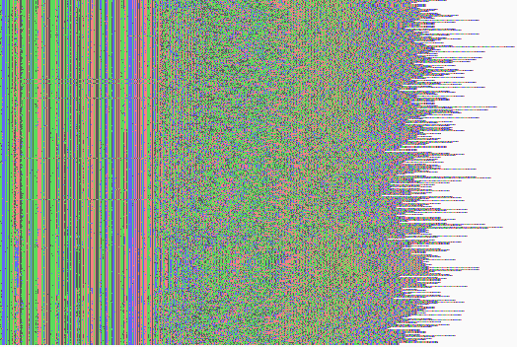
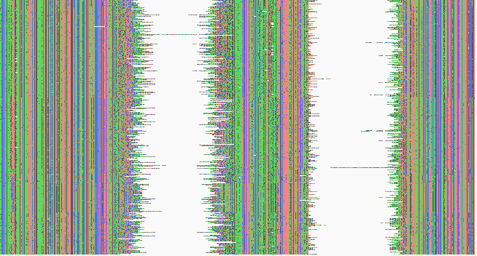
Gene Cutter Alignment
HIV V1/V2 sequences:
GeneCutterInput.FASTA
Result saved in Outputs folder
Alignments viewed with Pixel
http://www.hiv.lanl.gov/content/sequence/pixel/pixel.html
MAFFT alignment
GeneCutter alignment: “unalignable” regions compressed,
bases codon-aligned throughout.
File: GeneCutterOutput.FASTA
GeneCutter alignment
Can be viewed with BioEdit, Aliview, Se-Al or other multiple sequence alignment editors.
Options: translations of all genes in proper reading frames

Slide 33
TreeMaker
Check for phylogenetic relatives:
TreeMaker produces a Neighbor Joining tree for a quick comparison
TreeMaker uses PAUP* for its calculations; a few model options are available
Reference sequences can be included, and are aligned to the input automatically
Trees are displayed using PHYLIP and ATV
The alignment used for the tree can also be downloaded
PhyML and IQ-Tree Maximum Likelihood interfaces are also available
http://www.hiv.lanl.gov/content/sequence/PHYML/interface.html
https://www.hiv.lanl.gov/content/sequence/IQTREE/iqtree.html

Slide 34
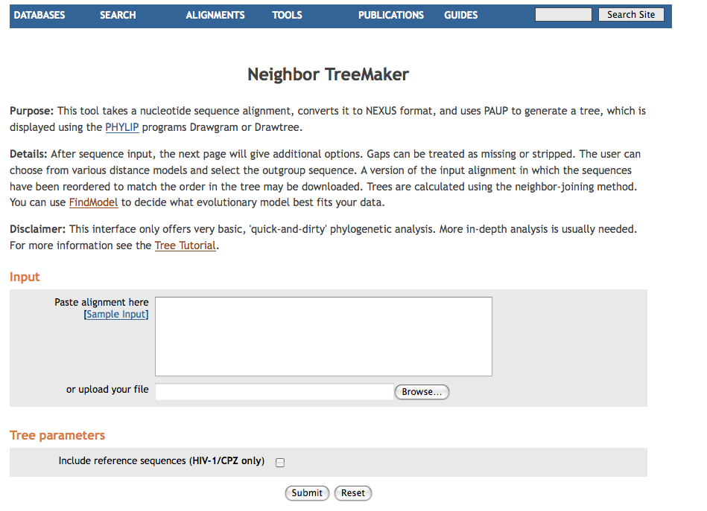
http://www.hiv.lanl.gov/components/sequence/HIV/treemaker/treemaker.html
Paste or type a DNA alignment here. Any organism.
OR upload an alignment file here.

Slide 35
http://www.hiv.lanl.gov/components/sequence/HIV/treemaker/treemaker.html
For this exercise
use the sample
input.
Include the
reference
sequences.

Slide 36
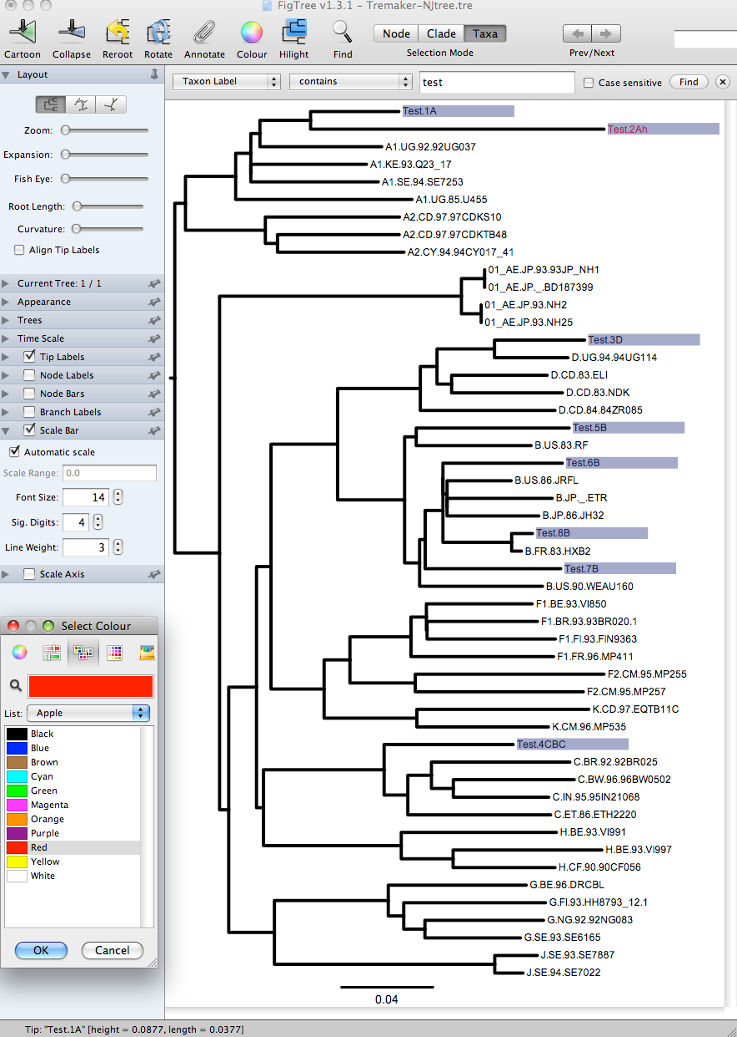
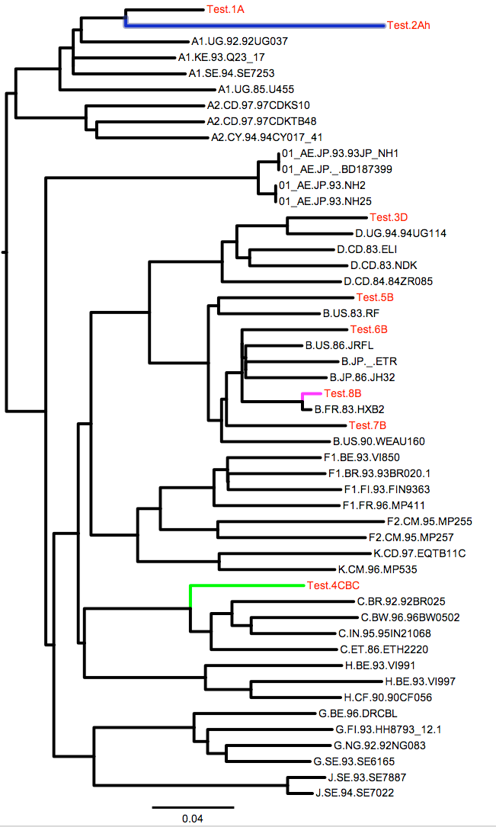
http://tree.bio.ed.ac.uk/software/figtree/

Slide 37
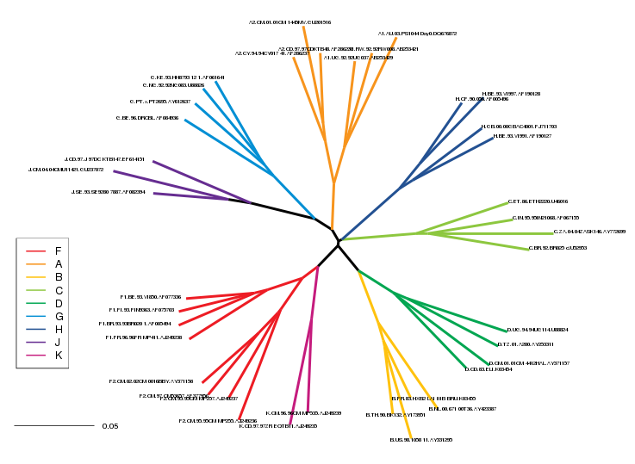
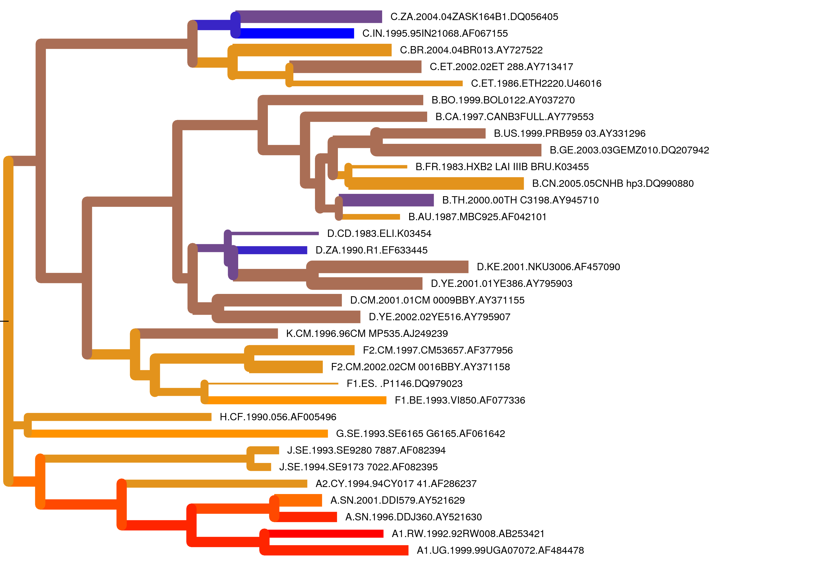
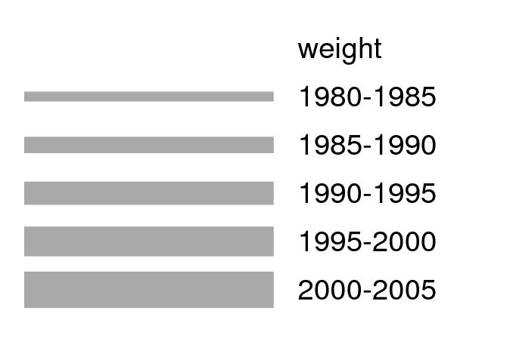
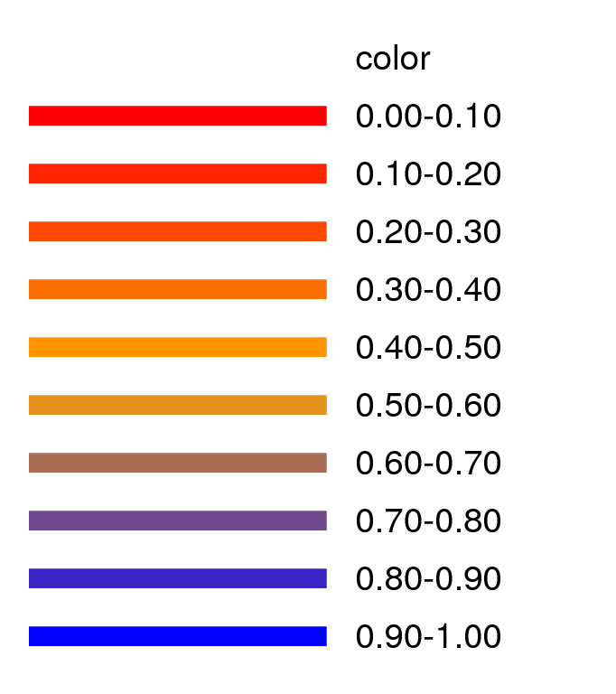
Making decorative informative trees for publication
Rainbow Tree
Colors branches based on strings in sequence names
AnnotateTree
maps quantitative information to branch weights and colors.
Date
Coverage

Slide 38
HIV/SIV Sequence Locator Tool
Instantly computes position numbers of DNA or protein fragments relative to a reference strain (HXB2r for HIV-1, SMM239 for SIV)
Such numbers, often included in the literature, are frequently incorrect
Shows the location of the sequence on an HIV map
Presents protein translations of DNA sequences
Can be used for input into the search interface, to align a new sequence you have generated with the database set
Can also retrieve reference sequences
by coordinates (range of base or amino-acid positions)
by single position (retrieves flanking sequences)

Slide 39
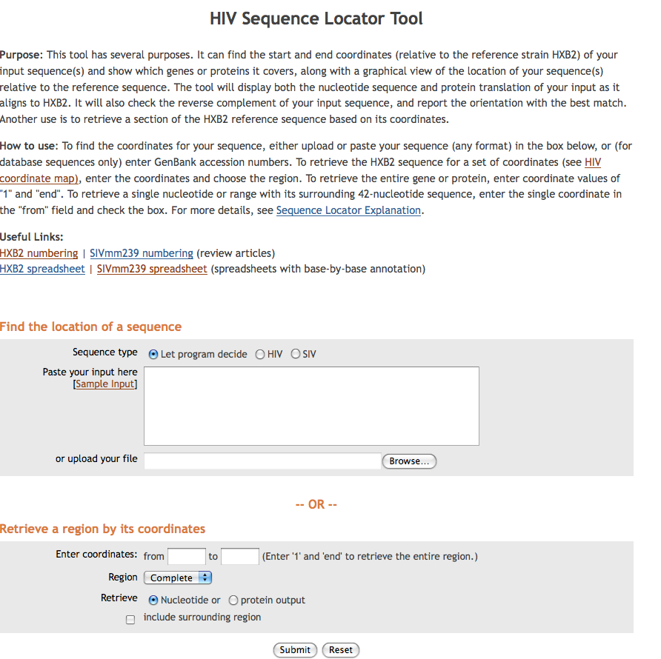
http://www.hiv.lanl.gov/content/sequence/LOCATE/locate.html
Paste or type a DNA or protein sequence here.
OR enter numeric coordinates here.

Slide 40
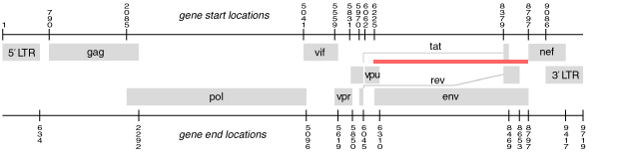
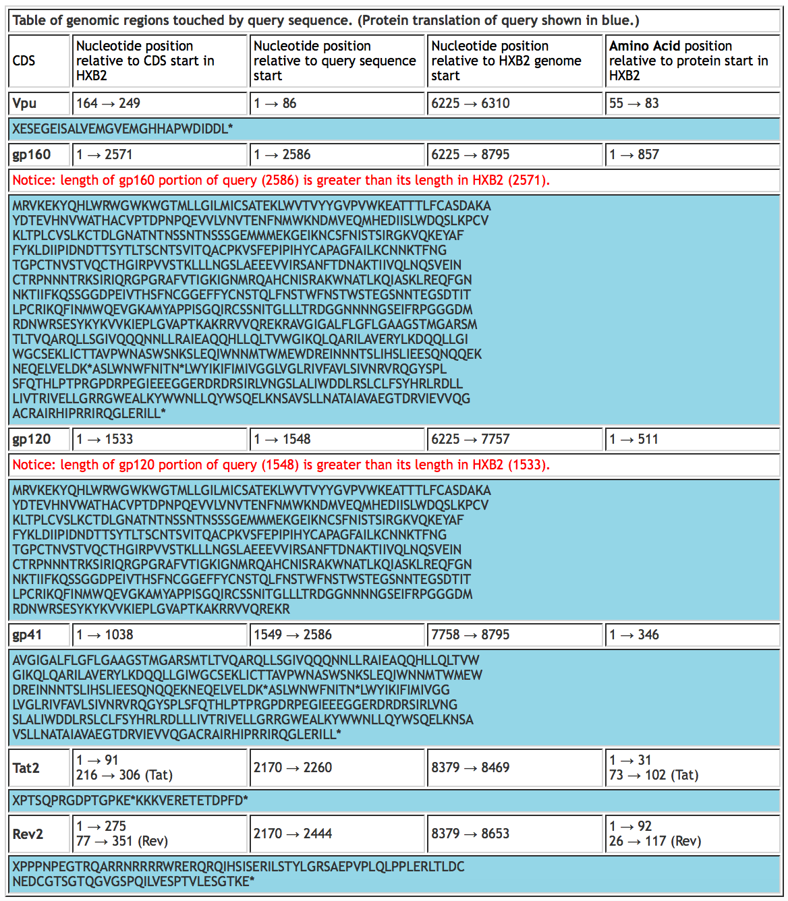
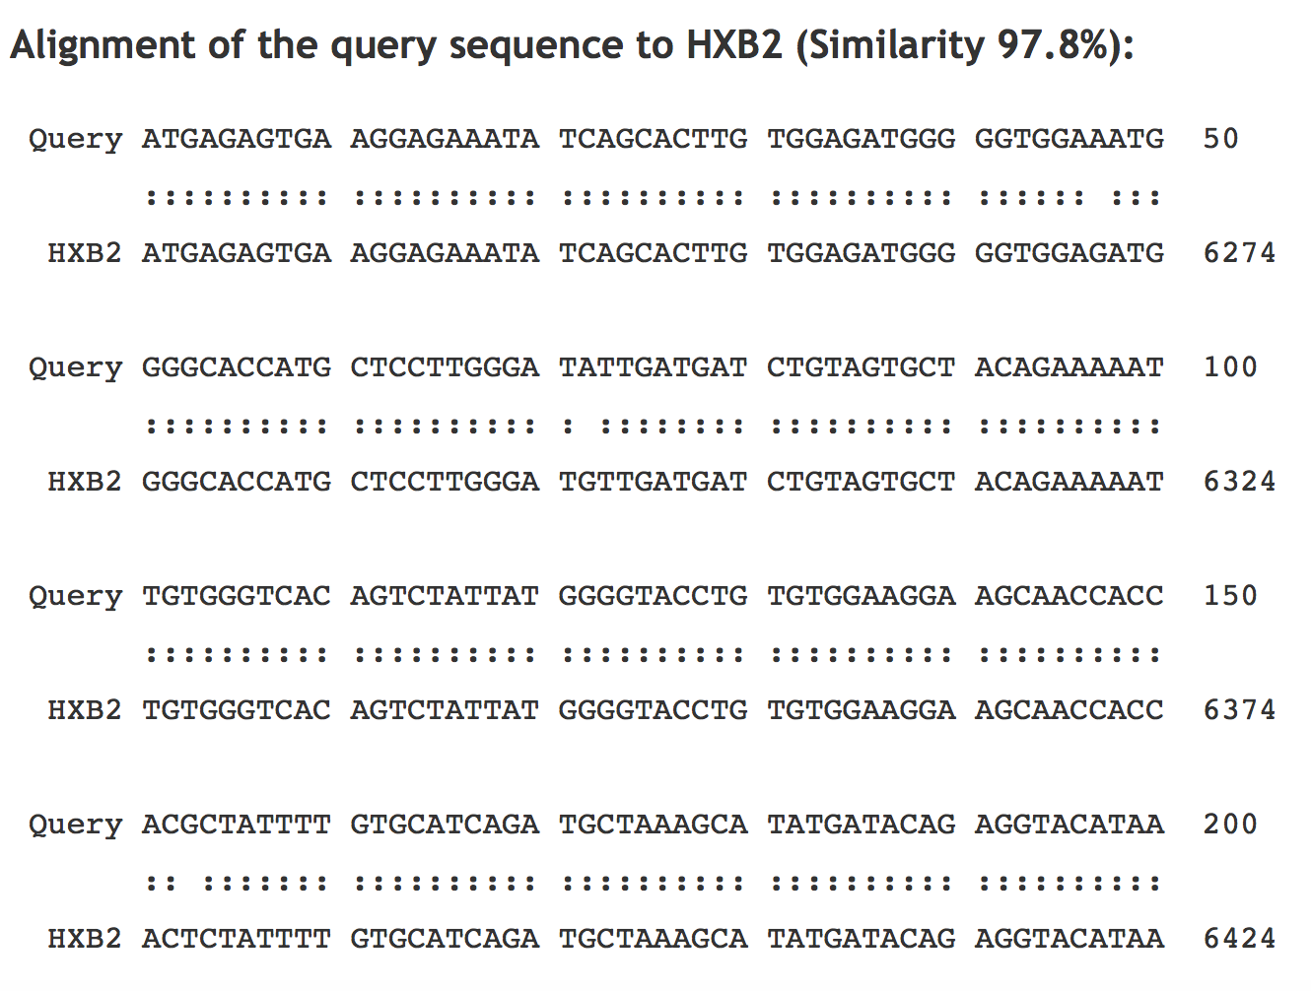
Sequence Locator:
(Results for sequence Test.8B)
Location in genome (red bar).
Numeric coordinates (useful for entry on search form) for DNA and amino-acids in all reading frames, with translations

Slide 41
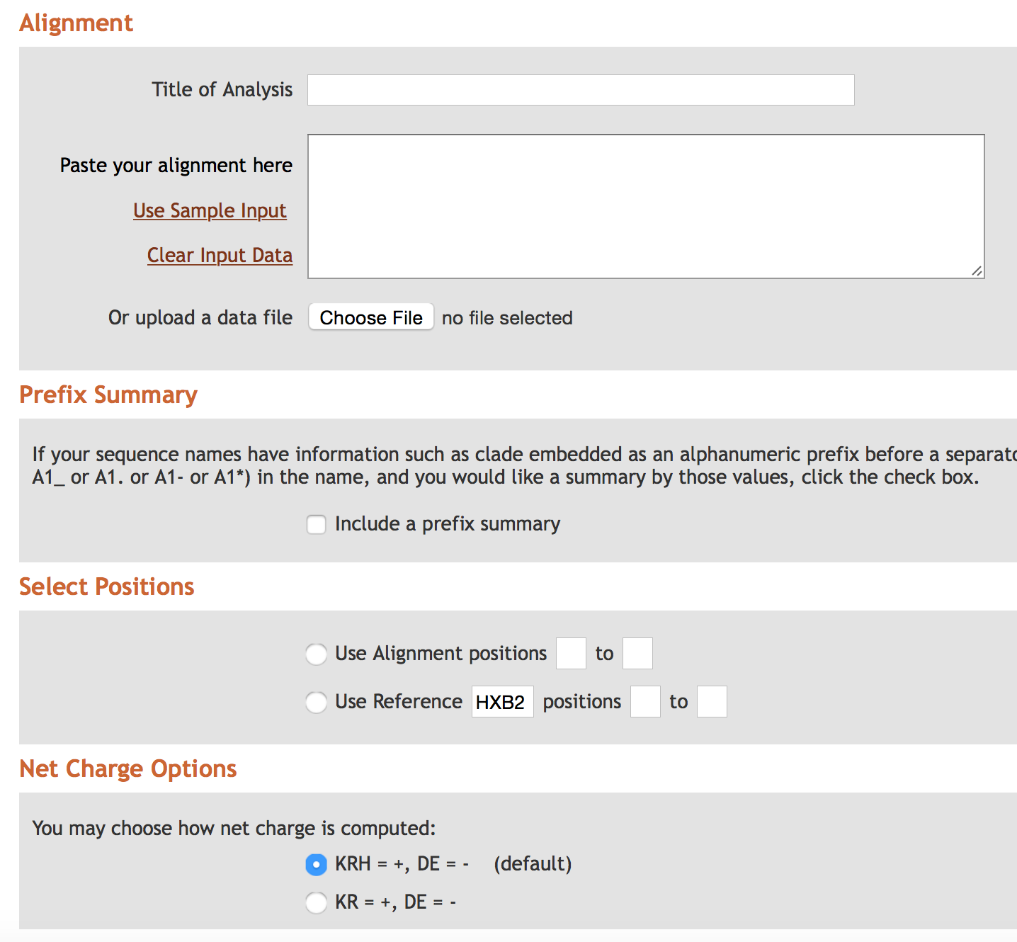
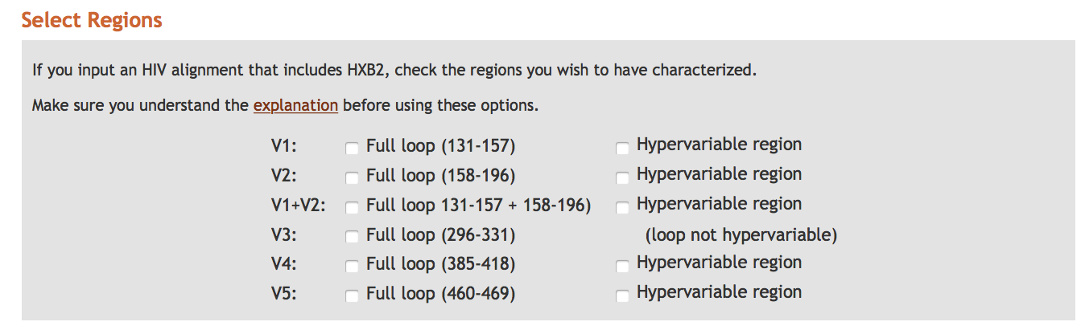
Variable Region Characteristics
Purpose: Variable Region Characteristics analyzes protein sequences for V1, V2, V3, V4, V5 and reports length, glycosylation sites, and net charge.
Details: The tool accepts a set of aligned protein sequences in Fasta, IG, table, and other formats, along with an optional reference sequence.
Allows comparison of unalignable regions w.r.t. properties relevant to antibody binding
For HIV, pulls out defined variable regions from alignment,
Computes lengths, charge, and number of PNG sites

Slide 42
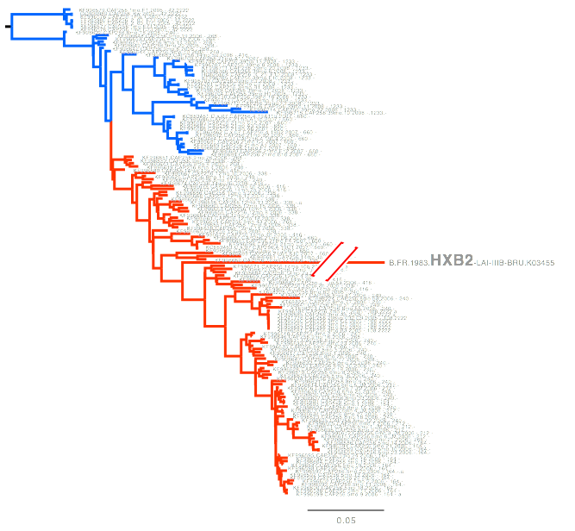
Variable Region Characteristics
Length
Glycosylation sites
Charge
Length
Glycosylation sites
Charge

Slide 43
Highlighter
Highlights mutations relative to a reference strain, particularly useful for intra-patient analyses.
Highlights:
syn/non-syn
transition/transversion
APOBEC motifs
Sorts on similarity
Visualize recombination of closely related sequences

Slide 44
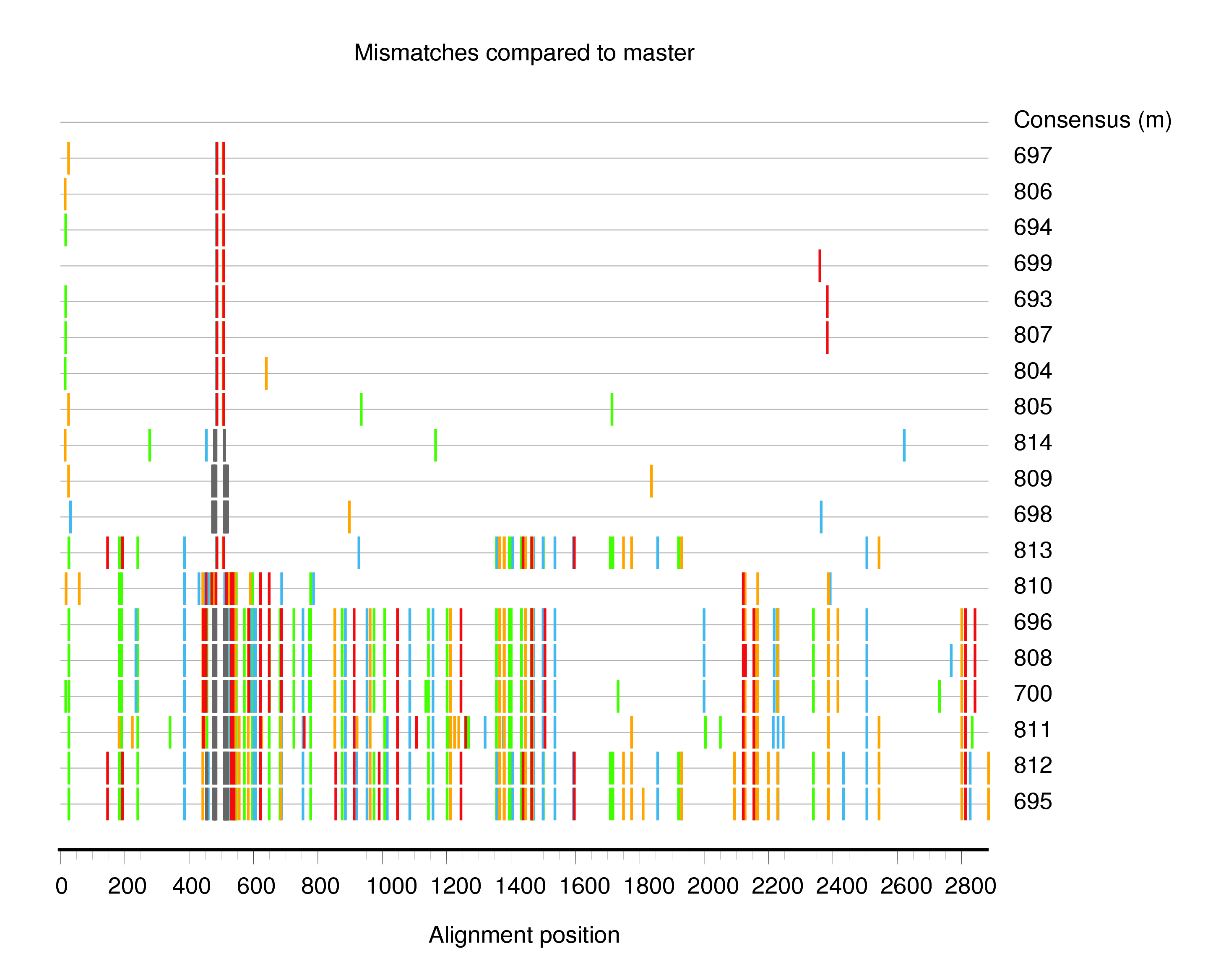
Highlighter sample data
Nonrandom distribution of mutations evident.
Sample Set is from a likely dual
infection, with intra-subtype recombinants present.

Slide 45
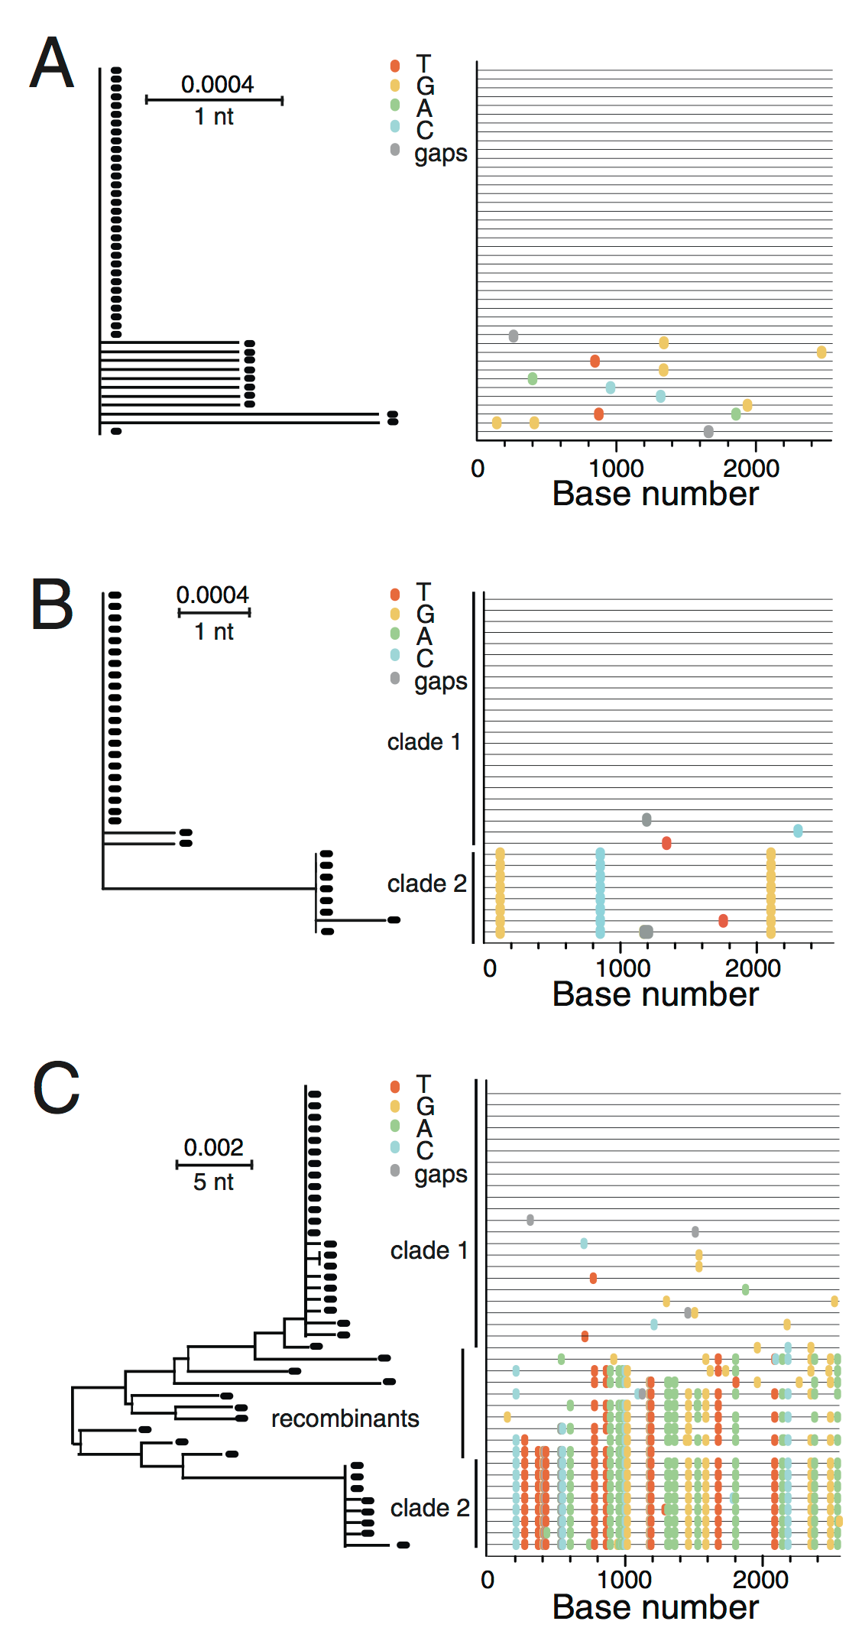
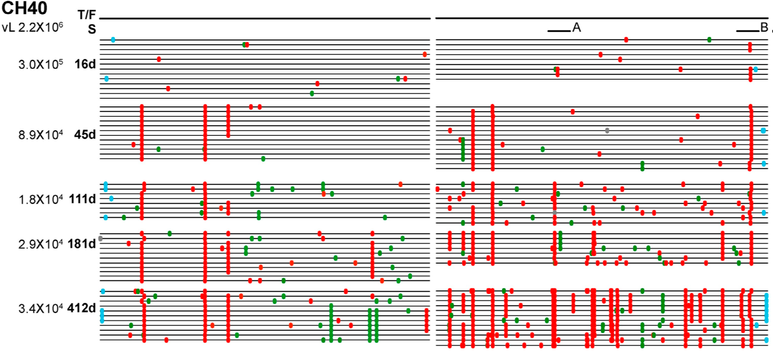
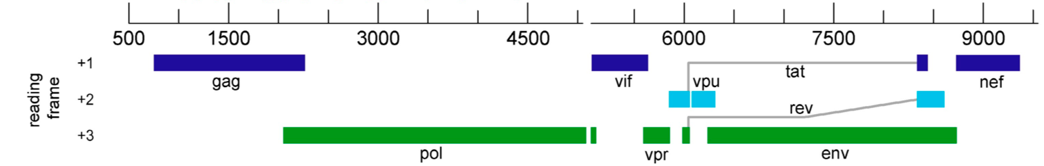
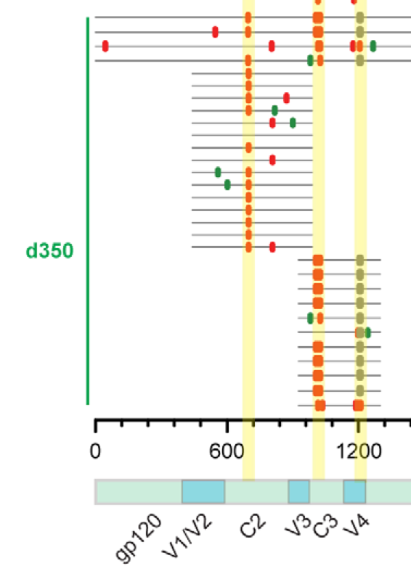
Highlighter examples
J.F. Salazar-Gonzalez, M.G. Salazar, B.F. Keele et al. (2009) J. Exp. Med. 206:1273-1289
Infection multiplicity
CTL escape
Antibody escape
B.F. Keele et al. (2008) 􏰀 PNAS 􏰀105:7552–7557
Bar et al. (2012) PLoS Pathogens e1002721

Slide 46
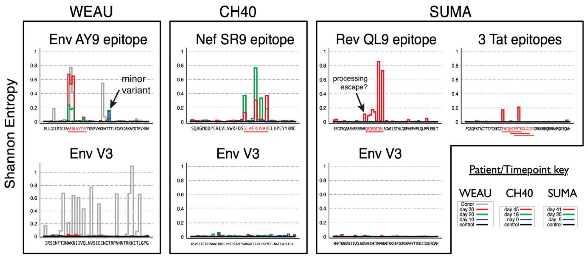
Entropy
Quantifies per-site variability within a sequence.
Highlights regions of rapid evolution:
CTL or antibody epitopes
Reveals dynamics of site changes (e.g. immune escape)
Fischer et al. (2010) PLoS_ONE 5(8): e12303.

Slide 47
Entropy

Slide 48
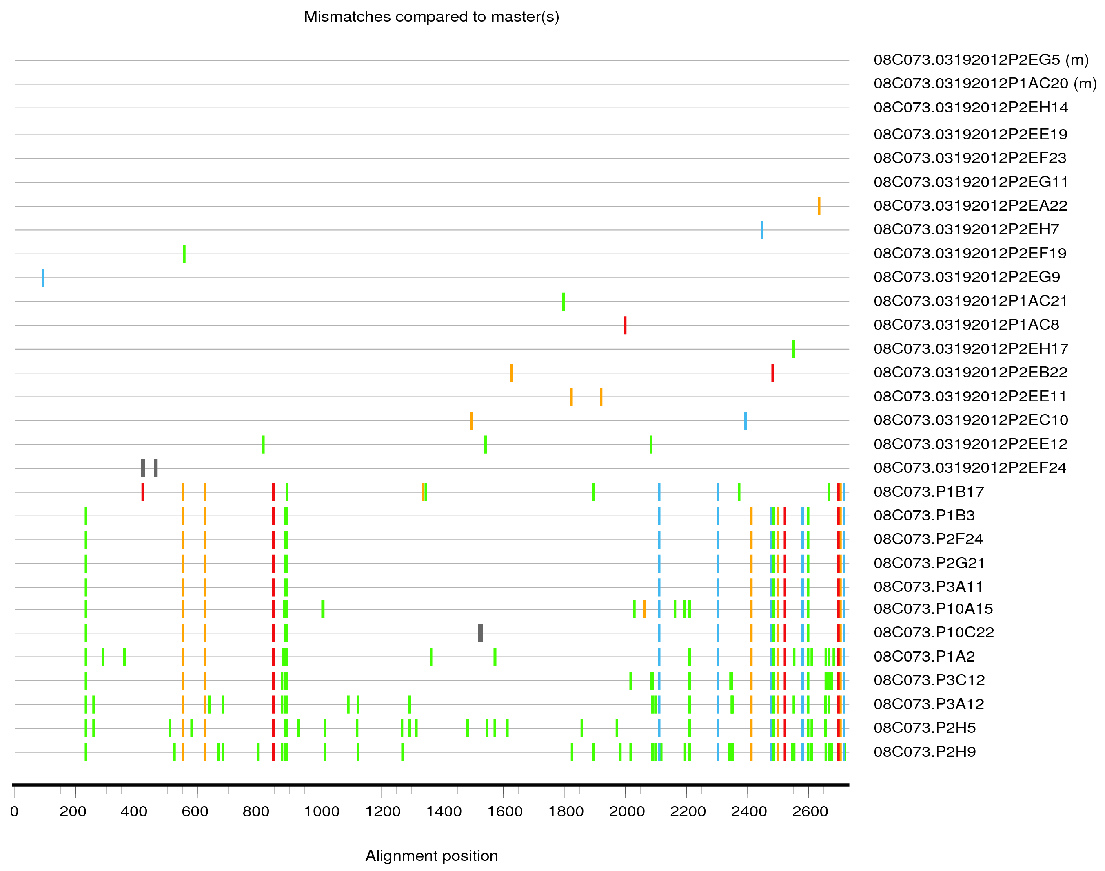
Hypermutation
Question:
Are all those “A” residues the effect of APOBEC-mediated G-to-A hypermutation?

Slide 49
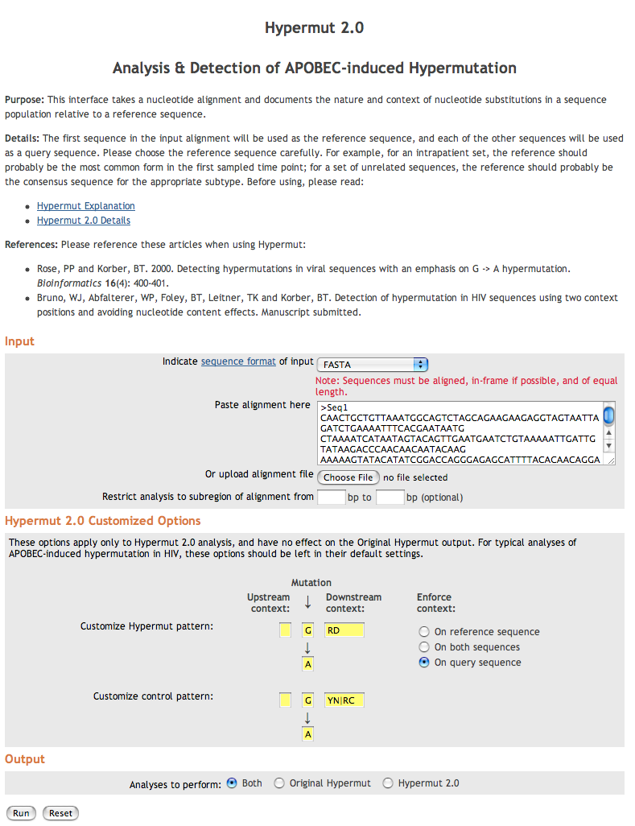
Hypermut Tool
Assesses statistical signal of hypermutation
Detects APOBEC-3G mediated G-to-A hypermutation as default
Can be adapted to detect any fuzzy motif in relation to a control pattern
An “easy version” is included in the QC tool
Some datasets are enriched for hypermutation, even when counts for individual sequences aren’t significant.

Slide 50
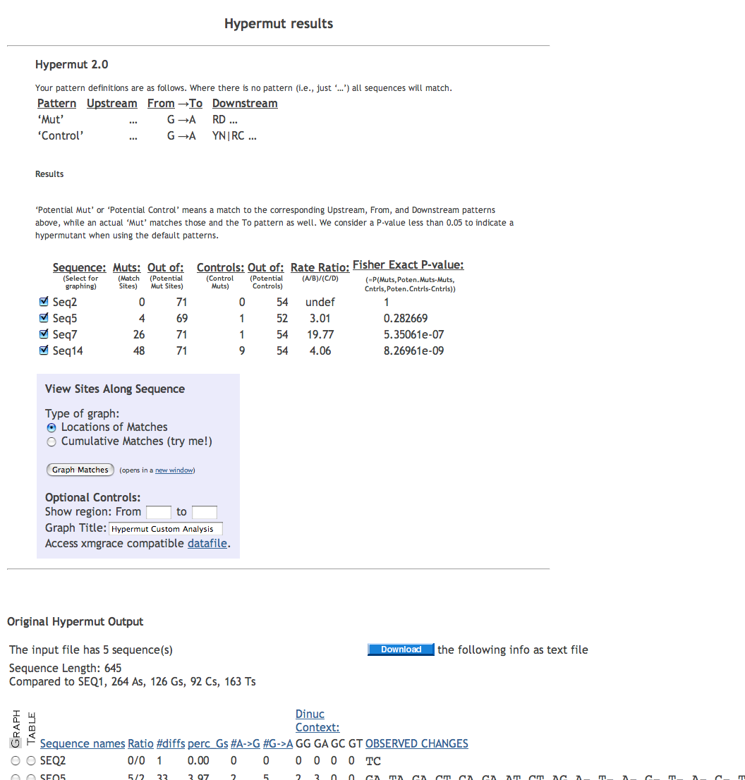

A significant excess of G-to-A mutations at APOBEC match sites (compared to non-match sites) indicates hypermutation.
Cumulative mutation
Graph is useful

Slide 51
Quality Control Tool
Incorporates existing HIV database tools
GeneCutter
RIP, BLAST
HyperMut (simple version)
Neighbor-joining Trees
Output is an email with link to a summary report
Why use it?
Prepare sequences for GenBank submission
Prevent database pollution
Avoid embarrassment!
http://www.hiv.lanl.gov/content/sequence/QC/index.html

Slide 52

Quality Control Tool
http://www.hiv.lanl.gov/content/sequence/QC/index
After the QC analyses, you can continue directly to the GenBank entry creation tool.
GenBank preparation procedure requires a comma separated (CSV) spreadsheet of annotations, as described on the help pages.
http://www.hiv.lanl.gov/content/sequence/QC/field_help.html
Easy to enter in spreadsheet (export as CSV format), or in text editor
GenBank Entry Generation

Slide 53

Quality Control Tool
Summary of results from analysis programs
Useful for helping to determine subtype, hypermutation, mislabeling of samples, spotting (some) lab strain contaminants
Click on each result
link to see details of
each analysis.
Optional: prepare
results to submit
to GenBank.

Slide 54
Rules for (HIV) Sequence Data
LOOK AT YOUR SEQUENCES in a dedicated alignment editor
toggle between DNA and amino-acid views
look at large and small scales throughout the alignment
don’t implicitly trust machine alignment
Build a tree with samples plus references as part of initial analysis
Include sequences from all your samples
Include reference sequences (sensible outgroups!)
Include sequences previously generated in your lab! (Paranoia pays!)
Use robust sequence names
for public sequences include accession numbers
for new sequences include patient/subject IDs and relevant metadata (e.g. sample timepoints, tissue type)
Make highlighter plots for closely-related sequences
Use sequence locator to check genome and protein coordinates (epitope locations!)
Use our “Quality Control” pipeline for HIV sequences
Submit to GenBank
Call your mother

Slide 55
Thank you for attending!
Please fill out our evaluation form!
Your comments will help us with funding to provide future training.
Contact us: seq-info@lanl.gov or immuno@lanl.gov

